Slide 1

UNIVERSITY INSTITUTE OF ENGINEERING
DEPARTMENT OF AIT - CSE
Bachelor of Engineering (CSE)
Security and Data Privacy Laws and Standards (21CSF-433)
By: Ms. Merry K.P(E12903)
Assistant Professor
AIT CSE
Lecture-11
Protecting Programs and Data & Information and Law
DISCOVER . LEARN . EMPOWER

Slide 2
Chapter | Course Objectives
1.3 | Understand the unique challenges posed to law enforcement agents, policy makers and prosecutors
Chapter | Course Outcomes
1.3 | After completion of this course, the student will be able to Describe the legal requirements for the use of Trusted data, data collection, and storage.

Slide 3
Contents
1.3 Legal, Privacy and Ethical Issues in Computer Security
Protecting Programs and Data

Slide 4
Patent Prosecution in India
Patent prosecution is the process of drafting, filing, and working with the Patent and Trademark Office to establish a patent protection over the rights to a unique invention. Patent prosecution begins with a unique idea or design.

Slide 5
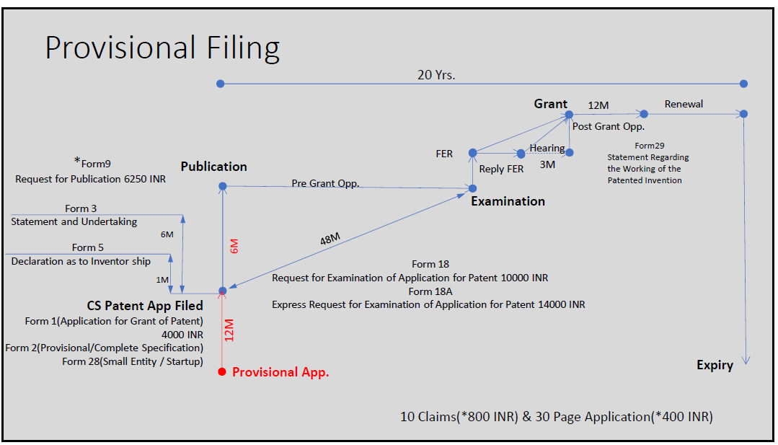

Slide 6
Fees
Fees | Form–1 | Form- 2 | Form-3 | Form–5 | Form- 9 | Form-18 | Form 26
Natural Person(s) | 1600 | No fee | No fee | No fee | 2500 | 4000 | No fee
Small Entity | 4000 | No fee | No fee | No fee | 6250 | 10000 | No fee
Other than small Legal entity | 8000 | No fee | No fee | No fee | 12500 | 20000 | No fee

Slide 7
Form No. | Process Title
1 | Application for Grant of Patent
2 | Provisional/Complete Specification
3 | Statement and Undertaking Under Section 8
5 | Declaration as to Inventorship
9 | Request for Publication
18 | Request/Express Request for Examination of Application for Patent
26 | Authorization of a Patent Agent/Or any Person in a Matter or Proceeding Under The Act

Slide 8
Indicative Indian Patent Renewal Fees (please check the latest status)
Sr. No. | On what payable | For Natural Person(s) (In INR) | For other than Natural Person(s) (In INR)
1. | Renewal fee for 3rd year – 6th year | 800 (for each year) | 2,000 (for each year)
2. | Renewal fee for 7th year – 10th year | 2400 (for each year) | 6,000 (for each year)
3. | Renewal fee for 11th year – 15th year | 4800 (for each year) | 12,000 (for each year)
4. | Renewal fee for 16th year – 20th year | 8,000 (for each year) | 20,000 (for each year)

Slide 9
Territorial Jurisdiction of Appropriate Office
Office | Territorial Jurisdiction
Patent Office Branch, Mumbai | The States of Maharashtra, Gujarat, Madhya Pradesh, Goa and Chhattisgarh and the Union Territories of Daman and Diu & Dadra and Nagar Haveli
Patent Office Branch, Chennai | The States of Andhra Pradesh, Karnataka, Kerala, Tamil Nadu and the Union Territories of Pondicherry and Lakshadweep, Telangana
Patent Office Branch, New Delhi | The States of Haryana, Himachal Pradesh, Jammu and Kashmir, Punjab, Rajasthan, Uttar Pradesh, Uttarakhand, Delhi and the Union Territory of Chandigarh.
Patent Office, Kolkata | The rest of India.

Slide 10
Advantages after Patent Filing
Commercialization
Start Up
Production-Marketing
Licensing
Selling

Slide 11
Patent Search
Search means to find out all applicable information related to invention and which is already existed before the date of invention.
Patent search is the process by which prior patented inventions are examined, with the goal being to find information that bears close similarity to a given patent or proposed invention.

Slide 12
Prior Art Search
Prior Art Search Includes:
Previous patents,
Trade journal articles,
Publications (including data books and catalogs)
Public discussions (conference and seminar)
Trade shows
Brochures,
Products, devices & equipment
Research Papers etc.

Slide 13
Need of Patent (Prior Art) Search
Understand competition
Avoid patent infringement
Write your patent application
Learn more about your field of invention
Save the cost of patenting process
Getting a general idea of how an application and patent is structured to help in the preparation or your own application
Learning more about a new field
For market information
Competitor tracking
Technology tracking

Slide 14
Tools for Patent Search

Slide 15
Free Databases
Free Databases | Web link | Scope of search
USPTO | http://patft.uspto.gov/ | US Patents only
EPO | http://ep.espacenet.com/?locale=en_EP | EP Patents WIPO patents World wide patens
Patent Scope (WIPO) | http://www.wipo.int/pctdb/en/ | WIPO Patents
Indian Patent Office | http://ipindia.nic.in/patent/patents.htm | Indian Patents (Granted as well as 18 month Published Patents)
Google’s Patent Search | http://www.google.com/patents | US patents only
Free Patents Online | http://www.freepatentsonline.com/ | US Patents EP Patents JP Patents WIPO Patents
BigPatent India | http://india.bigpatents.org/ | Indian Patents (Granted as well as 18 month published Patents)
Patent Facilitation Centre (PFC) | http://www.indianpatents.org.in/db/db.htm | Indian Patents (Abstract only)

Slide 16
Paid Databases
Paid Databases | Web link | Scope of search
PatSeer | https://acc.patseer.com/ | World wide patents
Micropatent | http://www.micropatent.com | World wide patents
Derwent | http://www.thomsonreuters.com/products_services/scientific/DWPI | World wide patents
Aureka | http://www.thomsonreuters.com/products_services/scientific/Aureka | World wide patents
Delphion | http://www.delphion.com/ | World wide patents
LexisNexis | http://www.lexisnexis.com/patentservices/priorart/ | World wide patents
Dialog | http://www.dialog.com/ | World wide patents
Hoover | http://www.hoovers.com/free/ | World wide patents
Patent Search Express | http://www.patentsearchexpress.com/ | World wide patents
PatBase & Patent Insight Pro | http://www.patentinsightpro.com/ | World wide patents

Slide 17
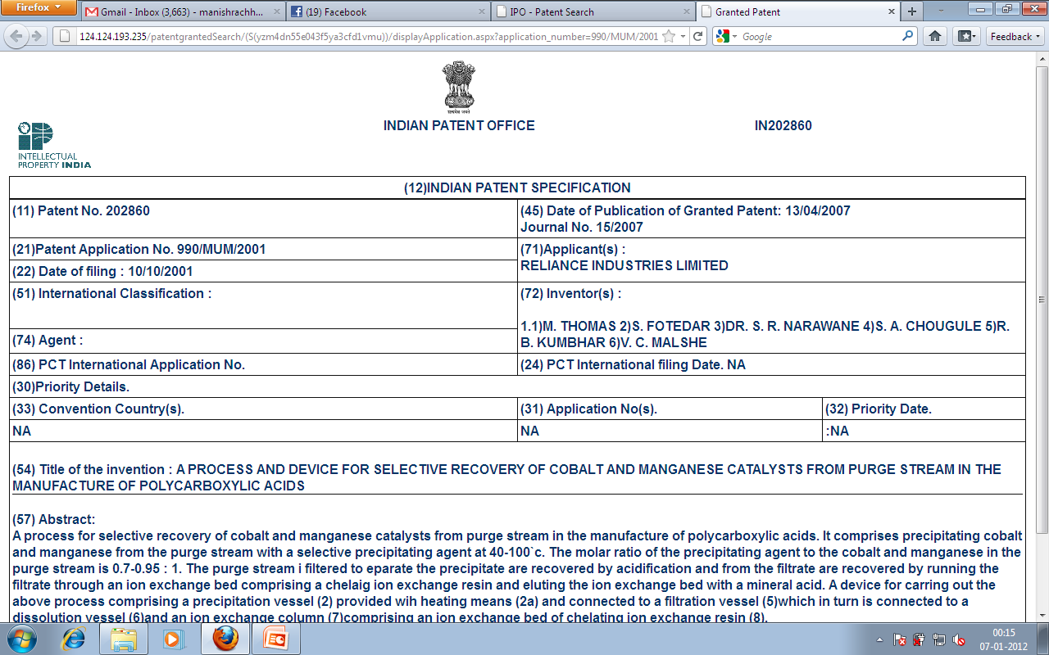

Slide 18
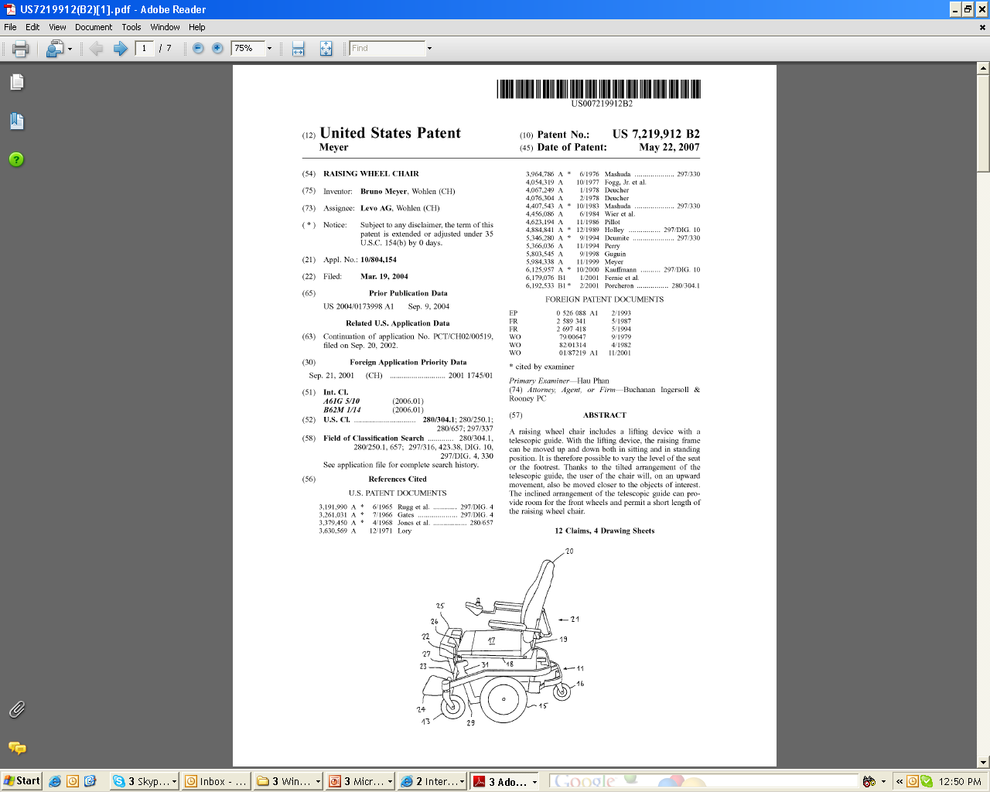

Slide 19
Copyrights

Slide 20




Symbolic Representation of various Copyright Logo

Slide 21
Copyrights
Copyright is a right given by the law to creators of literary, dramatic, musical and artistic works; and producers of cinematograph films and sound recordings.
Copyright ensures certain minimum safeguards of the rights of authors over their creations, thereby protecting and rewarding creativity.
The protection provided by copyright to the efforts of writers, artists, designers, dramatists, musicians, architects and producers of sound recordings, cinematograph films and computer software, creates an atmosphere conducive to creativity, which induces them to create more and motivates others to create.
(Copyright Office, Government of India)

Slide 22
Need of Copyright
Fair Play: Reward for creative efforts.
Exclusive rights for limited time: It is the kind of negative rights to prevent copying / reproduction.
Copyright is necessary: To encourage dissemination of copyrighted works in the context of the public interest.
It gives authors or artists the legal right to exclude others from using their works.

Slide 23




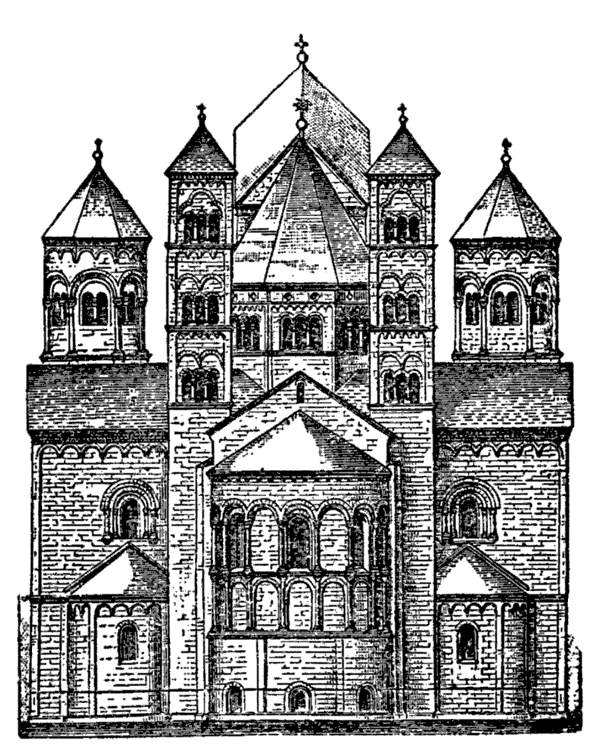
A Copyright Protects

Slide 24



Work Protection (Time to Rights Begin)
Work is protected by a copyright as soon as it is created and fixed in a tangible form.

Slide 25
Copyrights Do Protect
Copyright is automatic when a protectable work has been fixed in a tangible medium such as a CD, hard drive or any other storage medium.
A poem or picture is as much protected on a disk as on a piece of paper or on a canvas.
The copyright protection is available for published work and also for unpublished work
The work/ things protected under the copyrights includes:
Literary works (all text including computer software)
Musical works
Dramatic works
Pantomimes (Theatrical entertainment ) & choreographic works
Pictorial, graphic, & sculptural works
Motion pictures & other audiovisual works
Sound recordings
Architectural works

Slide 26
Copyrights Doesn’t Protect
The work/ things, which are not protected under the copyrights includes:
Ideas, concepts, or discoveries
Titles, names, short phrases, and slogans
Works that are not fixed in a tangible form of expression such as improvised speech or dance
Works consisting entirely of information that is commonly available and contains no originality
Anything written or created by the Government

Slide 27
Rights Granted to Owner
Basically, a copyright entitles you as the author of the work to do the following or let others do the following:
Make copies of your work
Distribute copies of your work
Perform your work publicly
Display your work publicly
Make derivative works

Slide 28
Copyright in India
India has a very strong and comprehensive copyright law (First Law came in existance-1914) based on Indian Copyright Act. 1957, amended took place in 1981, 1984, 1992, 1994 and 1999 (w.e.f. January 15, 2000).
The amendment in 1994 were a response to technological changes in the means of Communications like broadcasting and telecasting and the emergence of new technology like computer software.
The 1999 amendments have made the Copyright Act fully compatible with Trade-Related Aspects of Intellectual Property Rights (TRIPS) Agreement & fully reflects Berne Convention.
The International Convention for the Protection of Literary and Artistic Works, usually known as the Berne Convention, is an international agreement governing copyright, which was first accepted in Berne, Switzerland, in 1886.
The amended law has made provisions for the first time, to protect performers’ rights as envisaged in the Rome Convention. With these amendments the Indian Copyright law has become one of the most modern copyright laws in the world.

Slide 29
Term of Copyright
The general rule is that copyright lasts for 60 years.
In the case of original literary, dramatic, musical and artistic works the 60-year period is counted from the year following the death of the author.
In the case of cinematograph films, sound recordings, photographs, posthumous publications, anonymous publications, works of government and works of international organizations, the 60-year period is counted from the date of publication.

Slide 30
Features-Copyright Act 1957
The copyright act 1957 is valid from 21 January 1958, it has created Copyright Office and Copyright Board and Introduced civil and criminal remedies against infringement.
Performing Rights-Societies’ rights (for instance music royalties)
Definition of categories in which copyright actually survives
International copyright
Definition of infringement

Slide 31
Copyright Registration Flow Chart

Slide 32
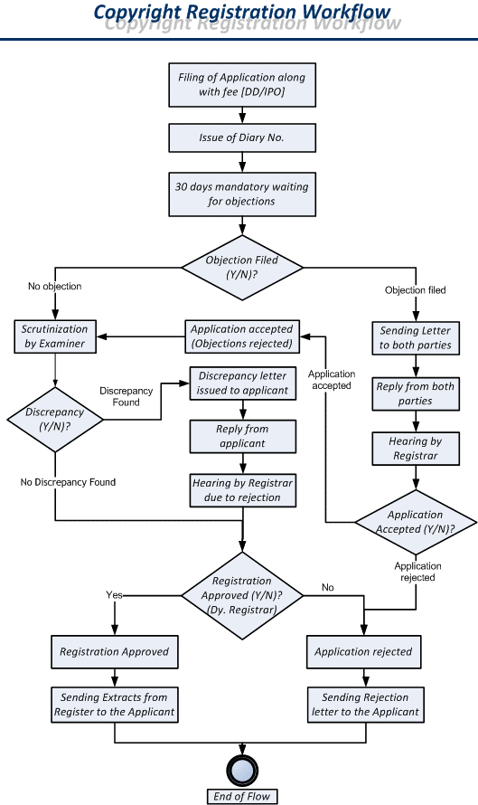
Source: http://copyright.gov.in/frmWorkFlow.aspx

Slide 33
Steps for Copyright Filing
Application for registration
Separate applications should be made for registration of each work
Each application should be accompanied by the requisite fee (please refer: http://copyright.gov.in/frmFeeDetailsShow.aspx )
The applications should be signed by the applicant or the advocate
The Power of Attorney signed by the party and accepted by the advocate should also be enclosed.

Slide 34
Copyright Registration for Software
While applying for copyright registration for a software, the ‘Source Code’ must be submitted along with the application for copyright registration to the Copyright Office.
Recommended Reading:
Step by Step process of Copyright Application in India
https://www.commerceduniya.com/2015/01/08/step-step-process-copyright-application-india/

Slide 35
Summary
Awareness about data protections
Security Protecting Programs and data

Slide 36
Home Work
Q1. Differentiate copyrights and patents and list down the requirement for patents.

Slide 37
References
Text Books:
V. D. Dudeja ,”Cyber Crime and Law Enforcement”, Commonwealth Publishers, 2003.
C. Davis,”IT Auditing: Using Controls to protect Information Assets”, TMH, 2011.
Reference Books:
Paul van Oorschot, computer Security and the Internet: Tools and Jewels (2020, Springer). Personal use copy freely available on author's web site.
Wenliang Du, Computer Security: A Hands-on Approach (2017, self-published). Updated May 2019.
Online References:
What is Data Protection and Why Do You Need It?: https://www.youtube.com/watch?v=SuNtmCgIhiM
Data Protection in Software Development: https://www.youtube.com/watch?v=mxusGZtPLos

Slide 38
THANK YOU
For queries
Email: merry.e12903@cumail.in

